Slide 1
Scaling Nodes on AKS
WorkshopPlus – Kubernetes Tech Briefing

Slide 2
Conditions and terms of use
© Microsoft Corporation. All rights reserved.
You may use these training materials solely for your personal internal reference and non-commercial purposes. You may not distribute, transmit, resell or otherwise make these training materials available to any other person or party without express permission from Microsoft Corporation. URL’s or other internet website references in the training materials may change without notice. Unless otherwise noted, any companies, organizations, domain names, e-mail addresses, people, places and events depicted in the training materials are for illustration only and are fictitious. No real association is intended or inferred. THESE TRAINING MATERIALS ARE PROVIDED “AS IS”; MICROSOFT MAKES NO WARRANTIES, EXPRESS OR IMPLIED IN THESE TRAINING MATERIALS¹

Slide 3

Topics
 | Nodes and Scaling
 | Node Autoprovisioning (NAP) aka Karpenter
 | Cluster Autoscaler

Slide 4
Nodes pools and Scaling

Slide 5
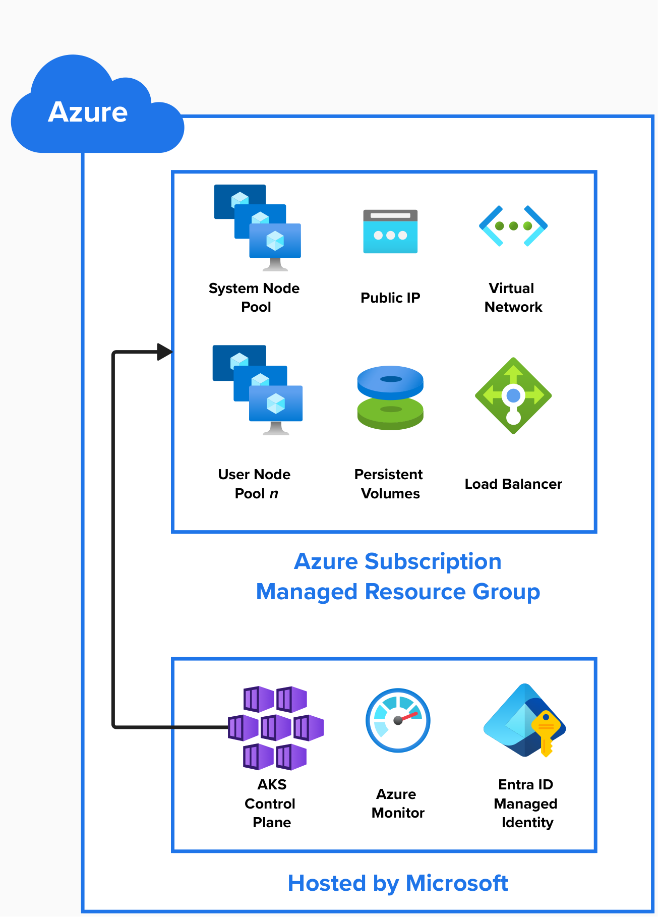
Nodes pool Types
System Node Pools
User Node pools
  Linux Node pools
    Ubuntu or Azure Linux
  Windows Node Pools
    Windows Server 2022
Supported VM Types
Notes:
Talk about System node pools and linux nodes pools
System Node Pools
Linux based
Need to support a minimum of 30 pods
Should not be used for underlying app workloads
Minimum of 3 Nodes
Should not be confused with the Kubernetes control plane
User Node Pools
Where the apps live
Consists of Windows and Linux nodes
Can be ubuntu linux or Azure linux

Slide 6
Scaling
Why do we need to scale nodepools?
  App availability
  Redundancy
  Reliability
General Scaling options
  Zone Spanning
  Zone Aligned
  Regional
Node scaling
  Node Auto Provision (NAP)
  Cluster Autoscaler
Notes:
Talk about general reasons for scaling and why its important to k8s.
Generally define Zone Spanning, Zone Aligned, and Regional Scaling. Go more indepth on the next slide
Generally define NAP and Cluster autoscaler. You will go more indepth later in the presentation

Slide 7
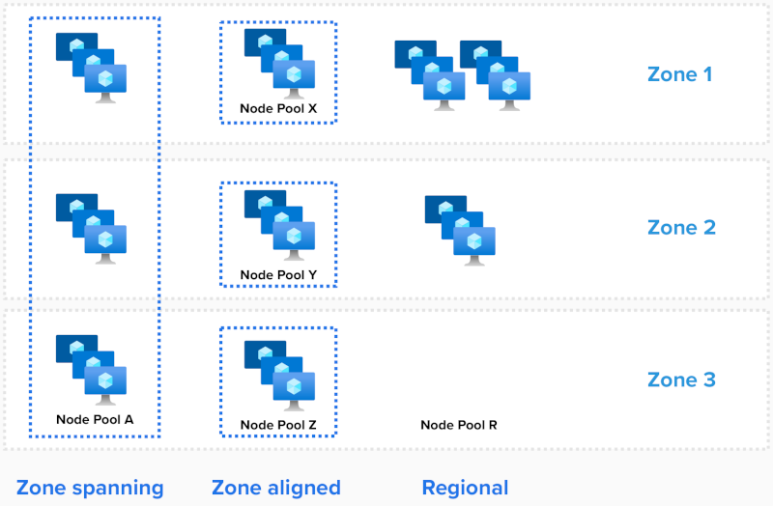
Scaling – Availabilty Zones
Notes:
Go indepth here on the scaling options
Zone Spanning
Spreads the scaling across all selected zones for the node pool
AKS balances the nodes between the selected zones
A zonal outage wont impact the nodes in other zones
https://learn.microsoft.com/en-us/azure/aks/availability-zones-overview#zone-spanning
Zone Aligned
Involes pinning nodes to zones. IE 3 nodes would be pinned to zones A, B, C
https://learn.microsoft.com/en-us/azure/aks/availability-zones-overview#zone-aligned
Regional
Nodes are created in the region
No guarantees that they are in separate zones or will be available in the event of a zonal outage
https://learn.microsoft.com/en-us/azure/aks/availability-zones-overview#regional-not-using-availability-zones

Slide 8
Node Autoprovision (NAP) aka Karpenter

Slide 9
What is it?
NAP allows for node auto provisioning on your cluster vs managing individual nodes pools and leverages the Karpenter OSS project.
Advantages:
  Watching for unscheduled pods
  Evaluating scheduling constraints put in place (resource limits, node selectors, affinities, tolerations ,etc) requested by the workload
  Provisioning nodes that meet the requirement of the workload
  Removing nodes when they are not needed
  Consolidating existing nodes onto cheaper nodes with higher utilization per node
Modes:
  Node Auto Provisioning (NAP) mode is a mode run by AKS as a managed addon similar to the cluster autoscaler
  Manual mode: the admin provisions karpenter as a standalone deployment in the cluster.

Slide 10
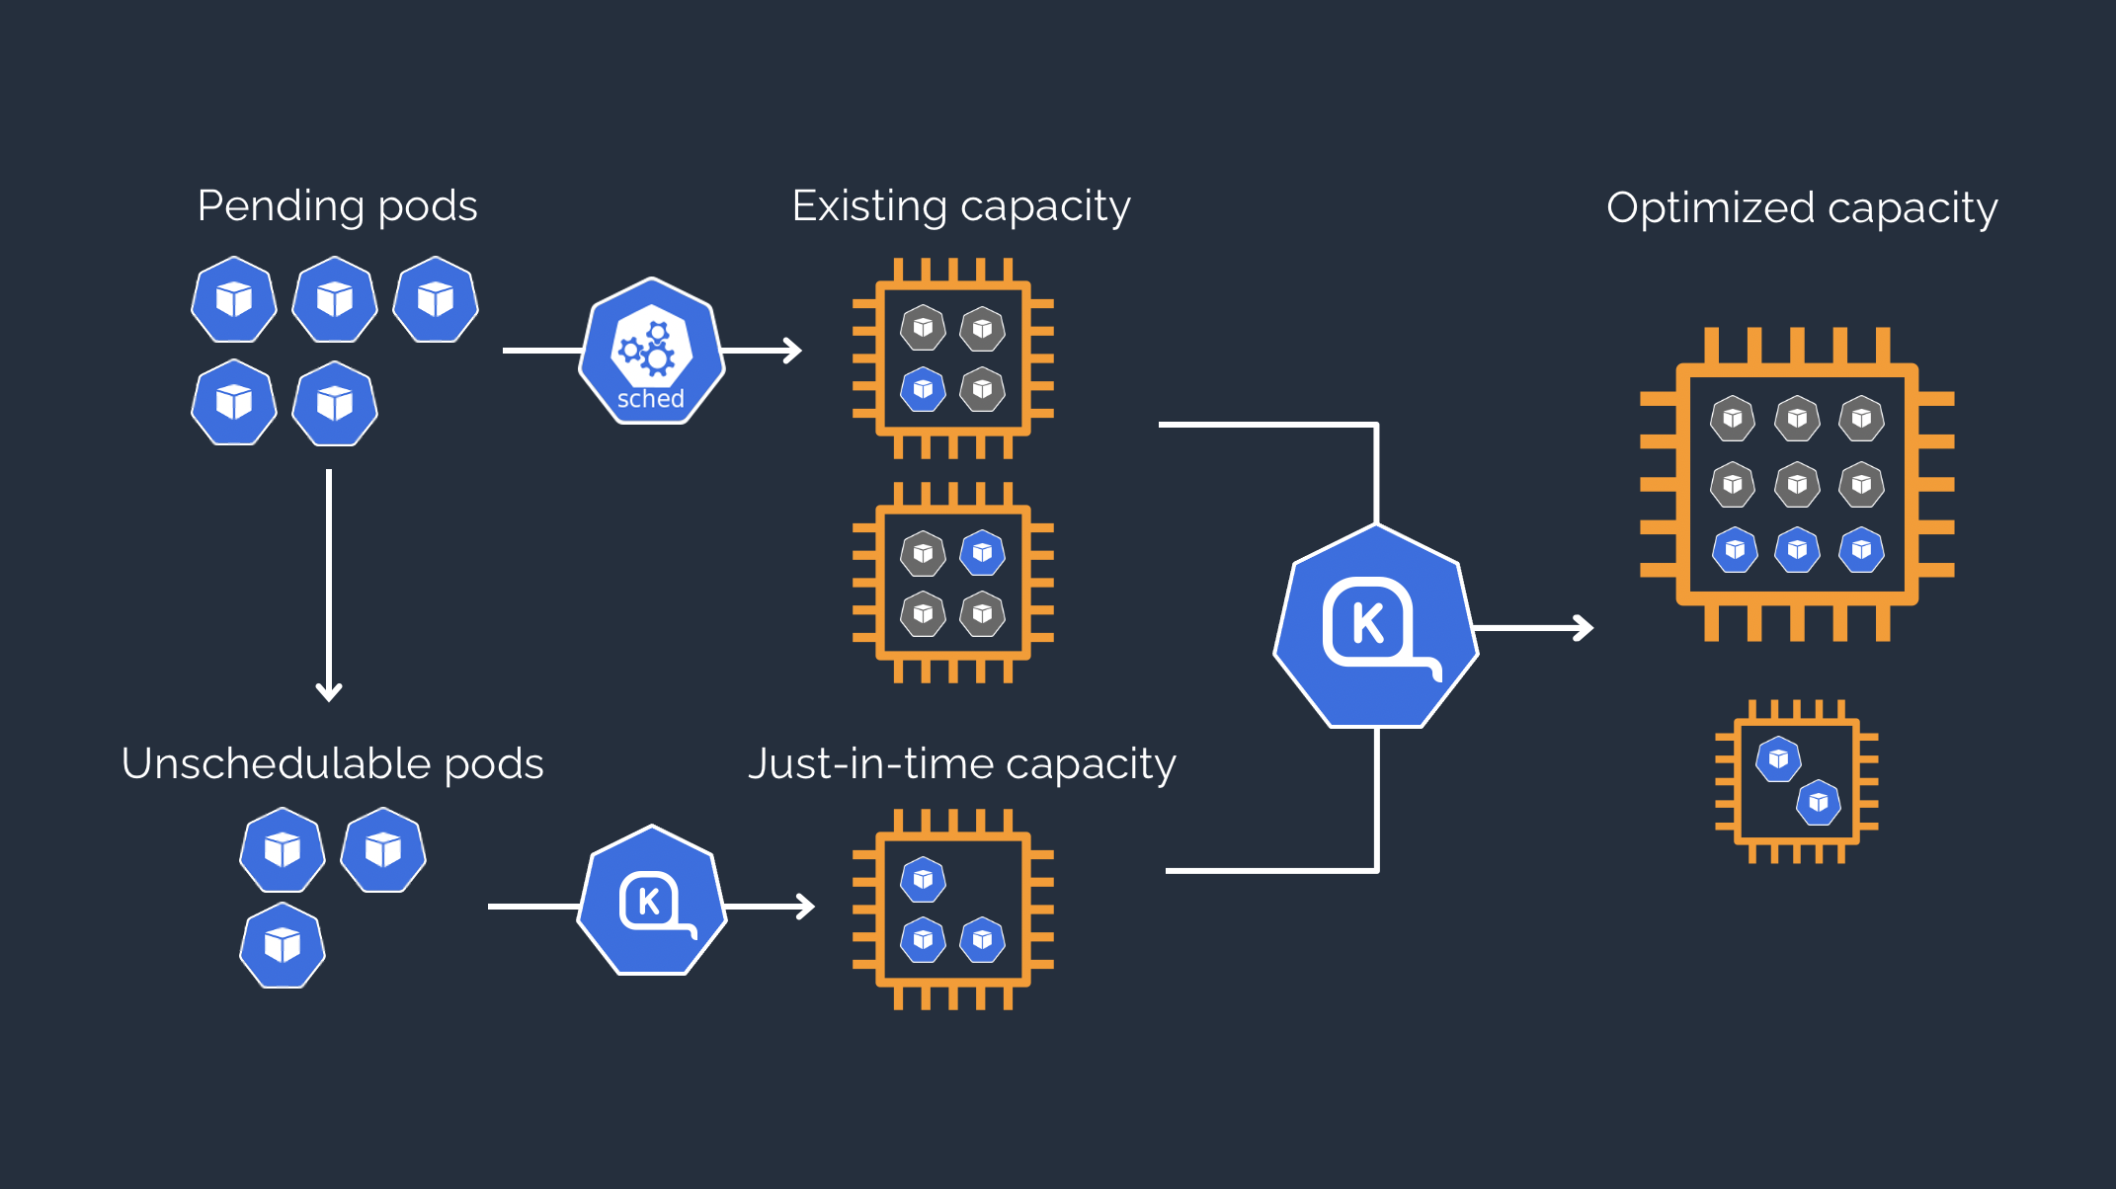
How it works
Notes:
Talk about how Karpenter works on the cluster and mention the advantages like Improved app availability, lower compute costs, and minizines the operational overhead.
Watching for pods that the Kubernetes scheduler has marked as unschedulable
Evaluating scheduling constraints (resource requests, nodeselectors, affinities, tolerations, and topology spread constraints) requested by the pods
Provisioning nodes that meet the requirements of the pods
Disrupting the nodes when the nodes are no longer needed

Slide 11
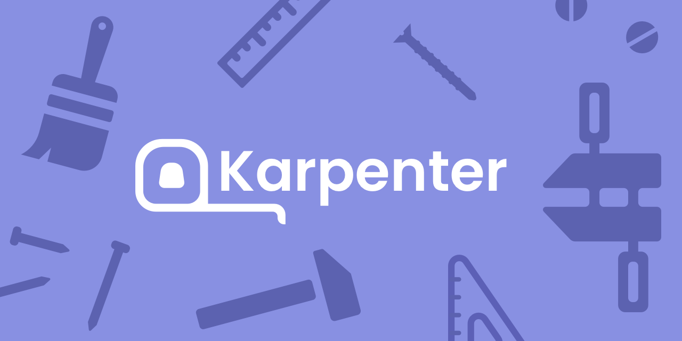
Demo
Karpenter YAML File overview
Workload deployment on a NAP enabled cluster
Notes:
Make sure to have a cluster created with karpenter enabled or record it beforehand so the customer can see how it works and is configured. Demoing via a WSL terminal, node pool view in the portal or using k9s is preferred.

Slide 12
Cluster Autoscaler

Slide 13
Traditional Cluster Autoscaler
Provides autoscaling for individual Nodepools based on the the OSS Kubernetes autoscaler
Each nodepool scales individually using the VM SKU type provisioned.
Scaling occurs when workloads cannot be scheduled due to constraints present in the cluster like:
  Lack of CPU available
  Lack of memory available
This increases the size of the existing nodepool based on the VM size specified in the node pool
Its not as efficient or cost effective as NAP the carpenter based scaler.
  Overprovisioning
  More rigid compared to NAP

Slide 14
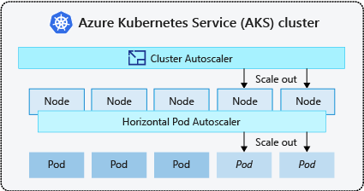
Traditional Cluster Autoscaler – How it works

Slide 15
Demo
Scaling using the cluster autoscaler
Notes:
Make sure to have a cluster created with karpenter enabled or record it beforehand so the customer can see how it works and is configured. Demoing via a WSL terminal, node pool view in the portal or using k9s is preferred.

Slide 16
Lab: Scaling Nodes on AKS
Lab Description
Deploying a Cluster with NAP and scaling an application
Deploying a Cluster with the Cluster Autoscaler
Notes:
Link to lab: https://labondemand.com/LabProfile/
##########

Slide 17
Questions?

